Slide 1




Rental ReStyle
Look Like a Million Bucks Without Going Broke
Prachi Sharma
Prithviraj Naidu
Vikita Nayak
Yogendra Sahu

Slide 2

Our Everyday Problem
Wearing something new over and over again and getting bored of it
Go on a Shopping spree and come home with a black hole in your pocket for things that you will only wear a few times
Work a 9-5 and want a power makeover to your wardrobe but end up shopping for fun non-work clothes, every time!
Hate the mall, long queues, laundry, cheap clothes and want to slash your shopping expenses but still want to wear that amazing dress for a big event.
Are you contemplating life while looking at your closet, seeing where all your money went and still got nothing to wear?

Slide 3

Challenge
Designer clothes that look as beautiful on you as they do online
The selection is really endless
Wasting time in shopping queue
Expensive!!

Slide 4
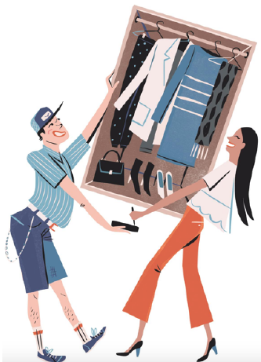
Business Description
Rental Restyle is an online rental service platform that enables the customers to rent designer outfits as per their needs
It features diverse types of dresses and outfits from various designers, catering to different occasions and multiple cultural groups for rent
At present we offer rental services for about 8 days at your doorstep across the Bay area

Slide 5
Business Need
An online portal for designers and customers where they can rent the collection based on latest trends, varying sizes and different designers for every occasion.
Doorstep delivery and pickup to make the dresses accessible at the customer’s convenience.
Dresses are made available at Pocket friendly prices
Maintain proper hygiene and condition of the dresses.
Utmost Customer Satisfaction

Slide 6
Business Requirement
System allows designers to create an account and upload all their designs in a catalog for customers to view and select.
System allows customers to create an account and browse through different designer catalogs to rent dresses and make payments online.
System helps with tracking the delivery status of the dresses from designer location to customer.
System automatically checks for out of stock dresses in the user selection and gives updated selection to user for approval.
The order system is followed by fulfillment and shipment process and customer is notified and provided with an order tracking number.

Slide 7
Why Rental Restyle?
Reducing time length: The system will help us bring high street fashion online, making the process of renting clothes hassle-free with the advent of technology.
Pocket Friendly Prices: It will reduce the cost of buying actual dresses for the customer as they can rent dresses which they would like to wear on a few numbers of occasions.
Adding Flexibility: The system aims at adding flexibility to the customers as well as the designers. The customers can access various dresses based on their dates, size and occasion across different designer labels.
Doorstep Delivery: Rental Restyle delivers the clothes from the designer store to customers specified locations.
Creation and Expansion of market share: The system will enable designers expand their market share by catering to a different market segment

Slide 8




System Users
Customer : Performs search and rents clothes from application
Designer : Adds new clothes to the application
3rd Party Logistics : Takes care of delivery of rented clothes
3rd Party Payment Gateway : Verifies payment information
Admin : Verifies the designer

Slide 9
How do we run the business?
Registration & Activation
New Customers
New customers create a new user account and browse through the available collection of designer outfits to Rent.
New Designers
Designers create their account and add their outfits in the catalog as per the size, ethnicity and type.
New designers are validated by Rental Restyle’s system admin.

Slide 10
How do we run the business?
Browse & Add to cart
Browse through catalogs uploaded by Designers
Filter dresses based on
Size
Ethnicity
Latest Trends
Display available dresses based on filters
Display Selected dress details & availability
Update Cart items up on dress addition

Slide 11
How do we run the business?
Place an Order
Once the customer confirms his/her outfit they proceed to checkout to place the order.
Customers select, add or modify their shipping details and select their shipping preferences.
The customer’s payment is then validated by the third party payment gateway.
Once the payment is confirmed, the customer and designer get a notification via email confirming the order and receive the order number for tracking.

Slide 12
How do we run the business?
Process the Order
Customer confirms the order
Proceeds to payment gateway & provides payment details
3rd Party Payment Gateway authenticate the details
Customer receives payment confirmation
Order confirmation notification is sent to Designer of the ordered dress
Designer keeps the dress ready for pick-up

Slide 13
How do we run the business?
Returns
The system sends a reminder email to third party logistics house one day before the rental end date of the dress.
Customers are allowed to extend the rental period of the dress only 48 hours prior to the end of the rental period
Once the dress has been picked up from the customer, it is returned to the designer location.
The dress is inspected by the designer who updates the condition in the system.
On successful return the customer is asked for a review about their experience.
The system notifies the user if the dress is found damaged and deducts a certain fee from the security deposit.

Slide 14
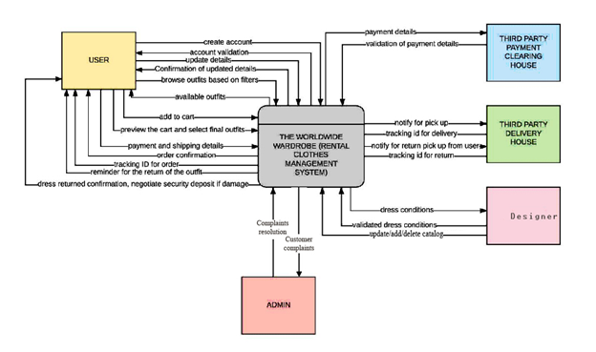
System Context Diagram

Slide 15
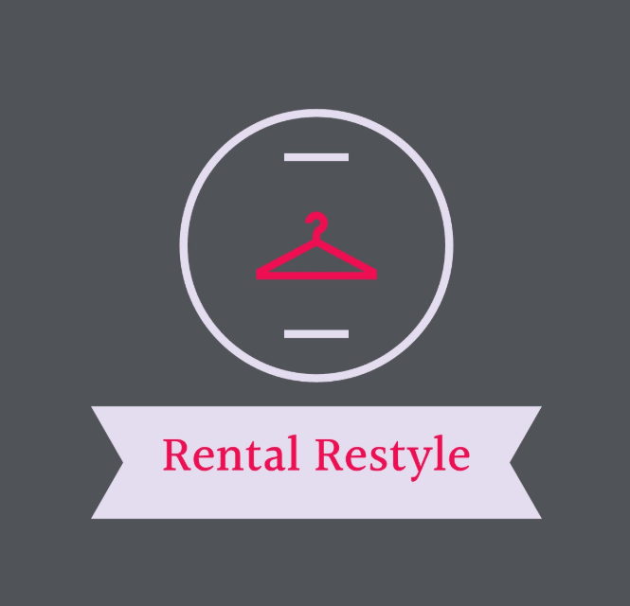
User Interface Demo

Slide 16
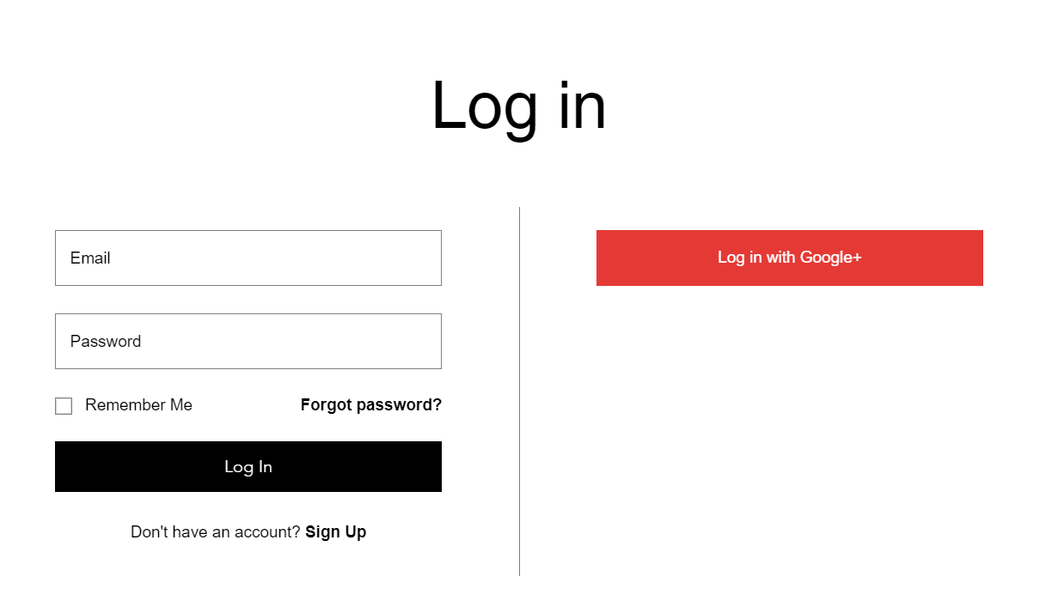
User Interface

Slide 17
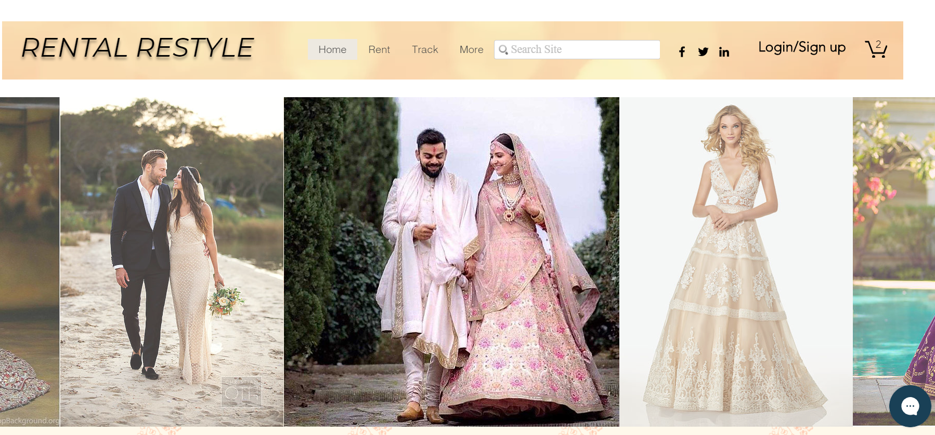
User Interface

Slide 18
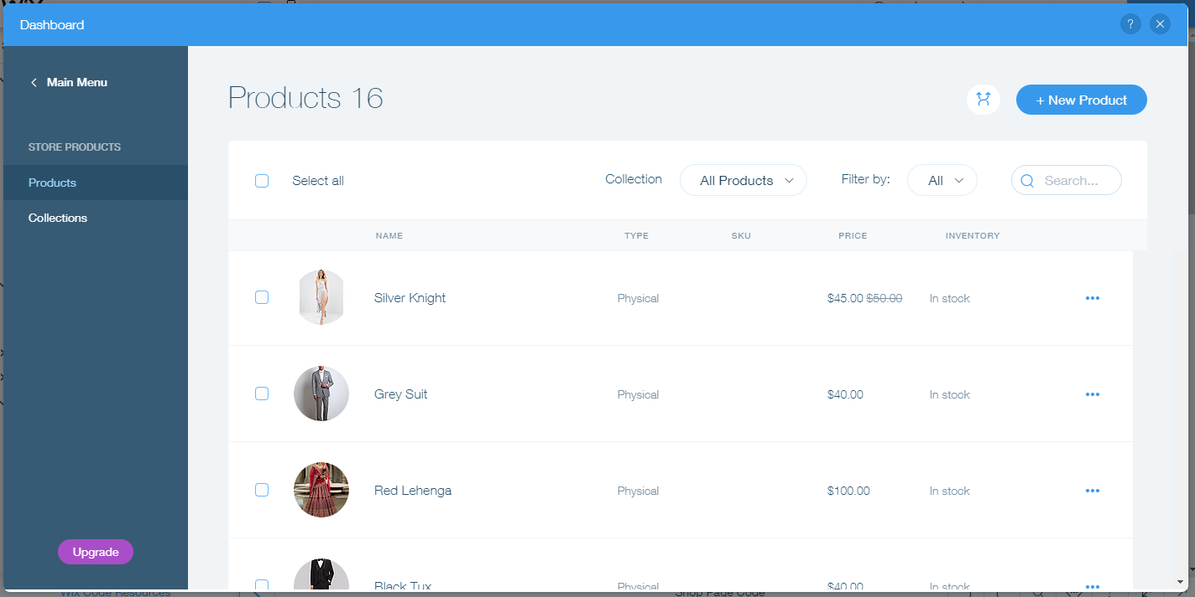
User Interface

Slide 19
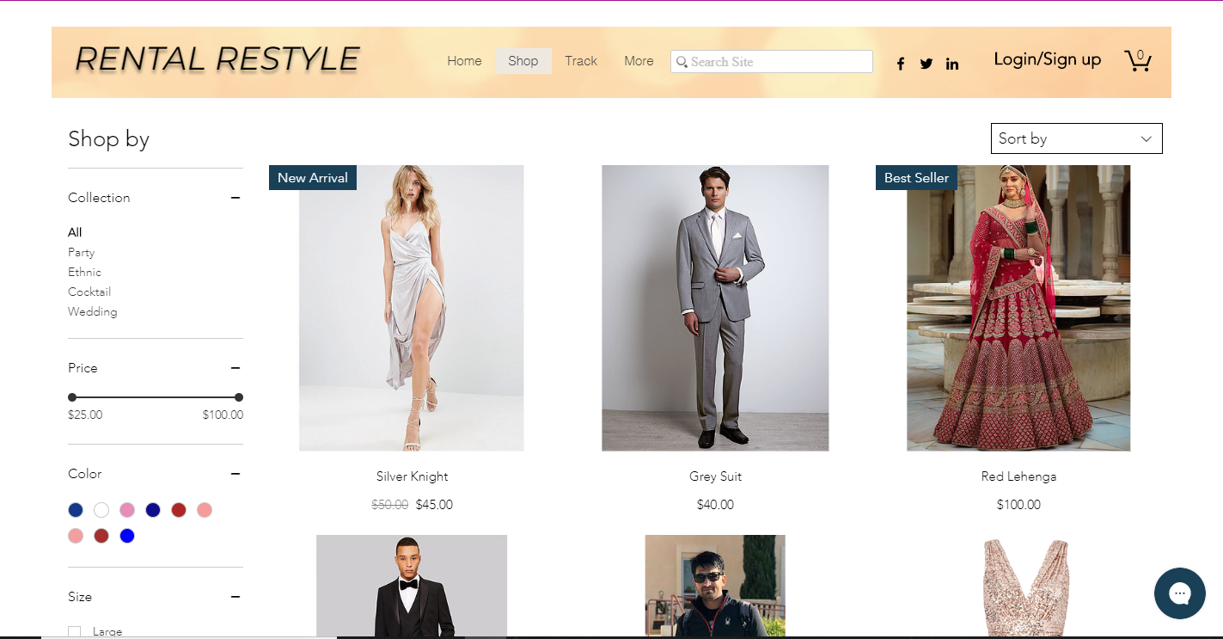
User Interface

Slide 20
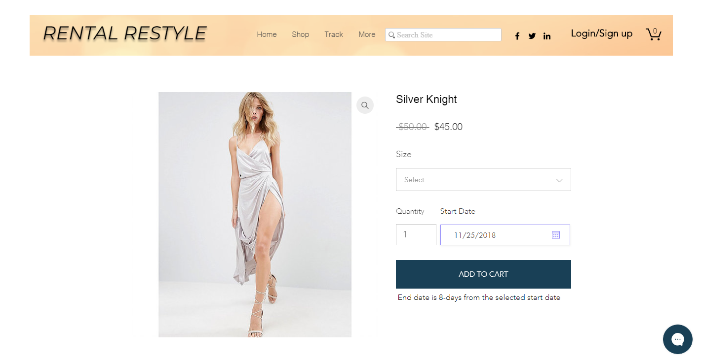
User Interface

Slide 21
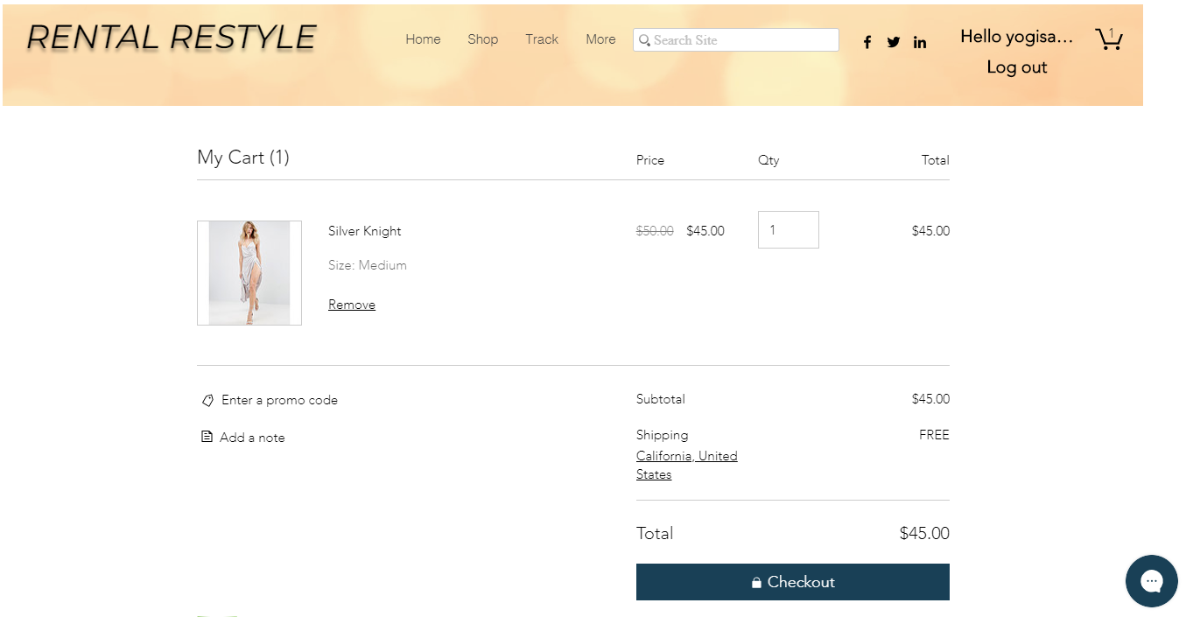
User Interface

Slide 22
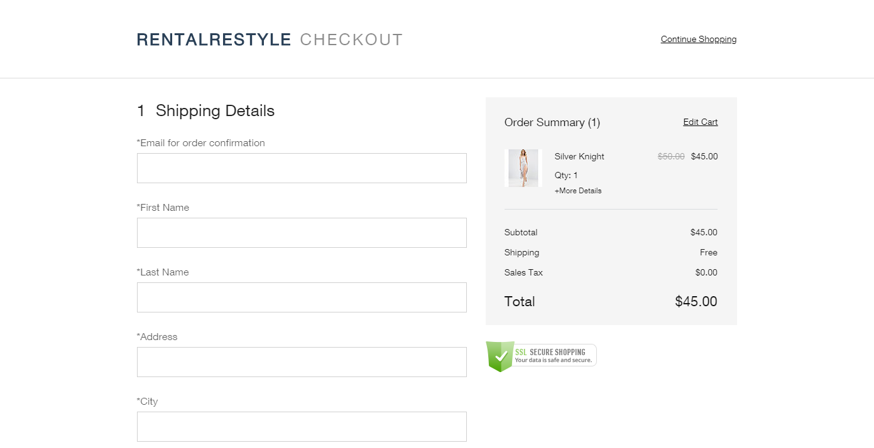
User Interface

Slide 23
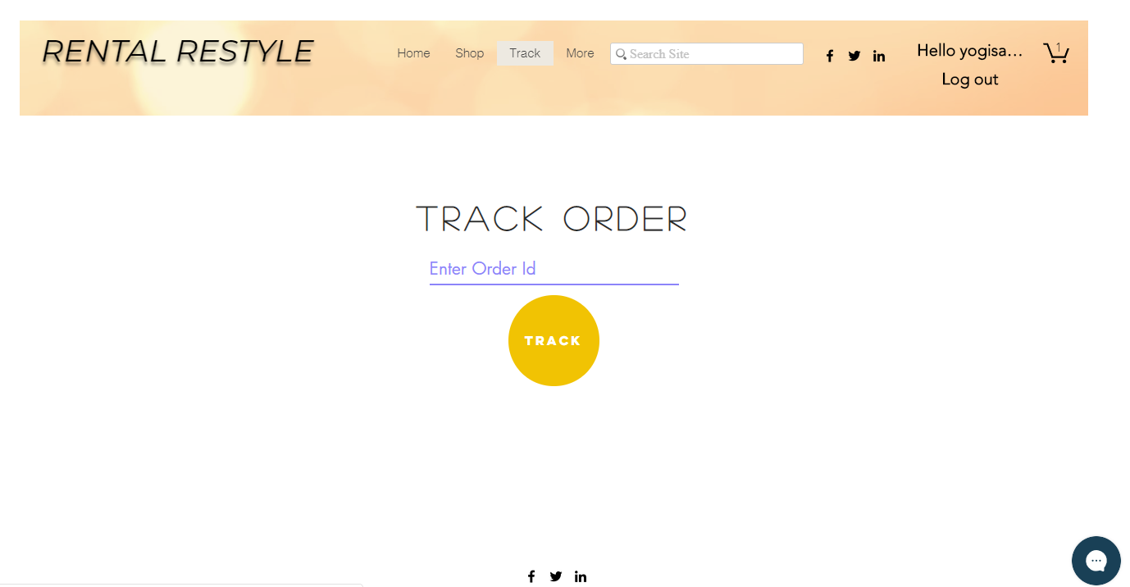
User Interface

Slide 24
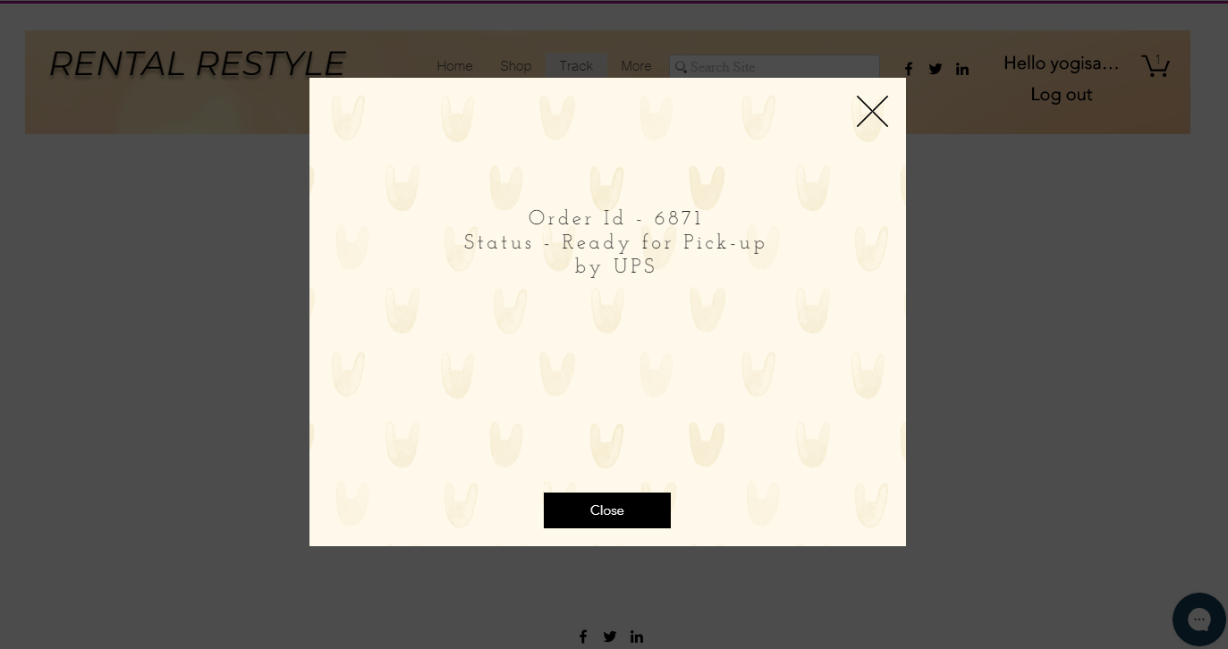
User Interface

Slide 25
Future Scope
Expand our business outside Bay area
Provide Customization of rented dress
Develop Mobile Application for IOS & Android device
Provide designer matching accessories with the rented dress

Slide 26
What we learned
Multiple Iterations of requirement revisions are required while designing DFDs and Use-cases
The importance of consistency
Understanding how AGILE methodologies works and how to update the requirements
Importance of task distribution, task assignment, responsibility and teamwork
Developed an analytical mind set about existing systems and started thinking about what goes into designing a system
Appreciating existing systems

Slide 27


